Slide 1
Agent-Based Modeling: Simulating the Spread
Directed Reading Program Fall 2025
Mahi K. Patel
Mentor: Kayla Kraeuter

Slide 2
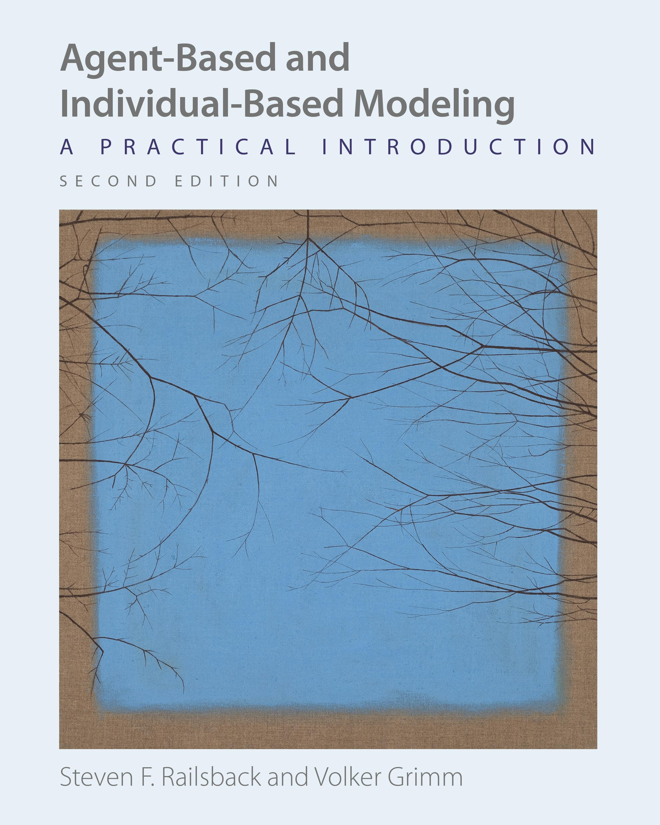
What is ABM?
Computer simulations used to study the emergent behavior that results from interactions between “agents” and their environment
Agents: people, places, things, etc.
Unique and individual
Useful for visualizing and analyzing complex systems in which patterns and diverse agents exist
NetLogo
Open-source ABM programming environment
Examples
SIR model, predator/prey, consumer behavior
Railsback, Steven F., and Volker Grimm. Agent-Based and Individual-Based Modeling: A Practical Introduction. Princeton University Press, 2011.

Slide 3
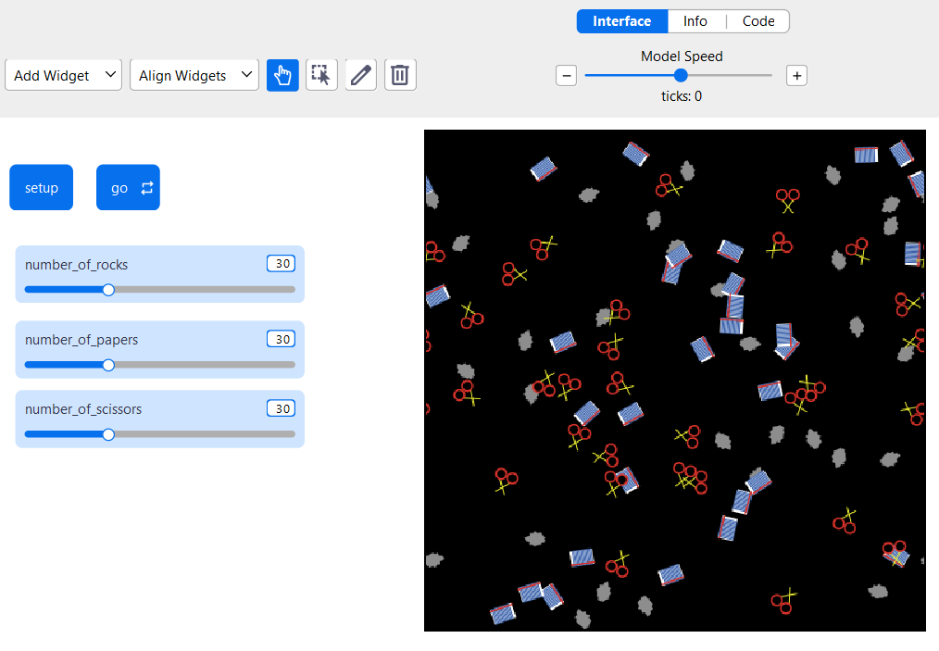
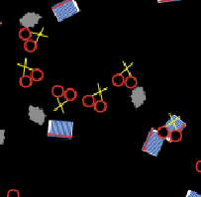
NetLogo: Rock, Paper, & Scissors Model
Clears previous game sets up patches and “turtles”
Plays the game
User chooses starting number of each type of player

Slide 4
Tumor Model
Problem/Task
To analyze the interactions between cancer, immune, and normal cells within a biological microenvironment
Cells are mobile
Immune cells target/move towards cancer cells
Immune: Cancer → normal
Drug efficacy limited in tumor core
Basic Assumptions

Slide 5
Tumor Model
Assumptions
Cont.
Immune cells recruit other immune cells and, together, increase efficacy
Increased spread in the core
How it Works/
Mechanism
Simulates tumor growth: cancer cells spreading to nearby cells
Immune cells try to kill these cells

Slide 6
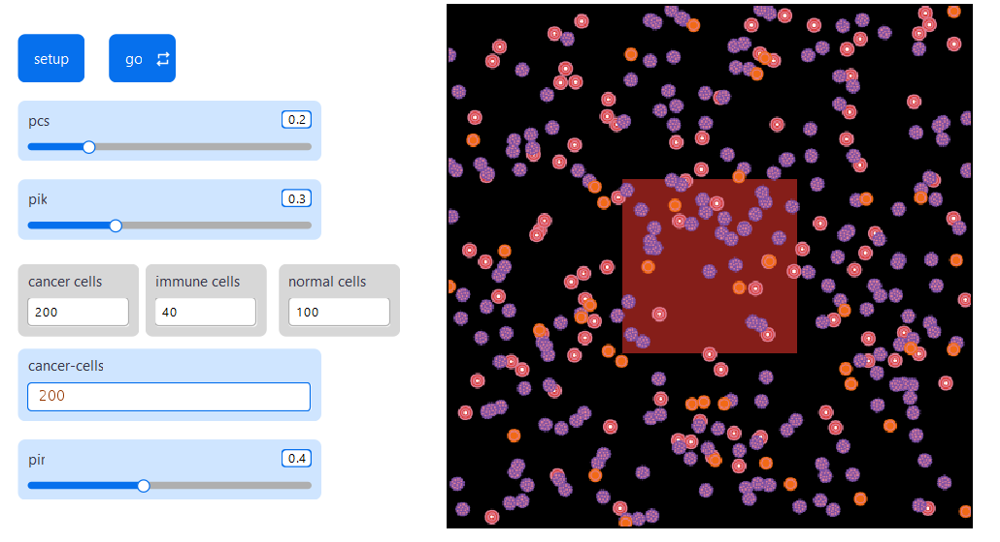
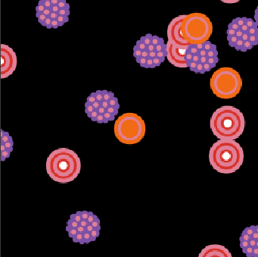
NetLogo: Tumor Model
Probability of cancer spread
Probability of immune kill
Counters : display a count of each cell type
User sets initial cancer cell count
Probability of immune recruitment

Slide 7
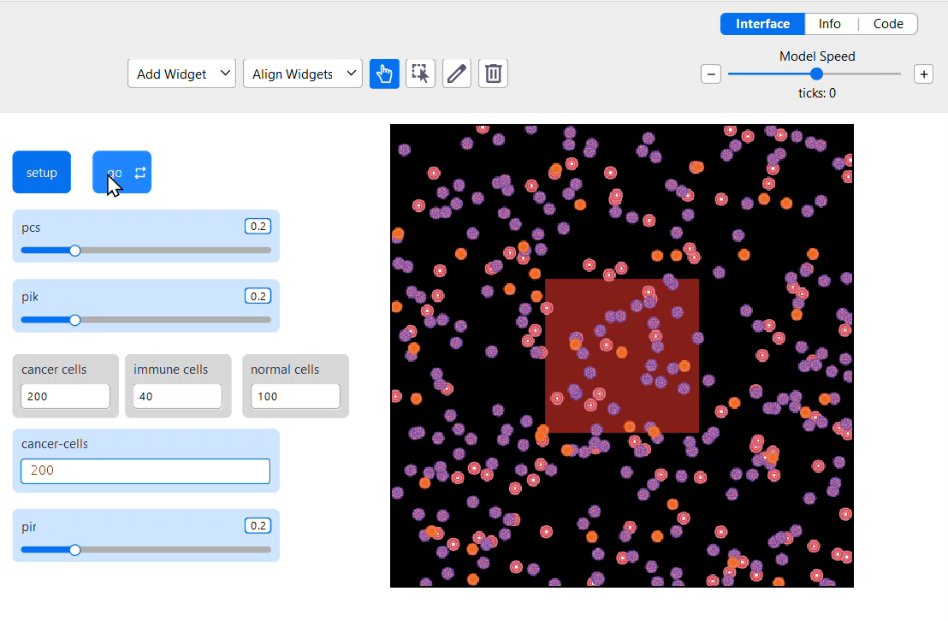

Slide 8
Agent-Based Modeling: Simulating the Spread
Directed Reading Program Fall 2025
Mahi K. Patel
Mentor: Kayla Kraeuter

